Slide 1

Lecture 8
User Input & Misc

Slide 2

Agenda
User Input
Libraries and npm modules
Handling User Input with prompt-sync
Structuring a Program

Slide 3
Handling User Input

Slide 4

Input
It is very important to handle input in programs
Many types of input - from human (keyboard and mouse), from other system, from a file etc
Almost all systems or softwares will require some inputs

Slide 5
Input
Input
System/
Software/
Program
Output

Slide 6
User Input
Come from mouse, keyboard, touch screen etc
For Node.js command line programs - we will use keyboard (as we all know, mouse won’t work in CMD)
E.g. I build a game, and users will need to input their “decisions” by keyboard

Slide 7
Number Guessing Game Example
> What’s your name?
Darren
> Hello Darren, Let’s try to guess a number in my mind.
> I have a number in my mind. It is between 0-100, guess it
50
> It’s too large. Next guess?
25
> It’s too small. Next guess?
37
.
.
.

Slide 8
Libraries

Slide 9
Libraries
Programming language is really just a language
aka - there are no “features” built-in
Features means some commonly used code, functions, and utilities
  reading user input
  reading csv, jpg, xlsx, docx files
  sending requests to server
  drawing user interface
  handling date and time
  handling array and objects

Slide 10
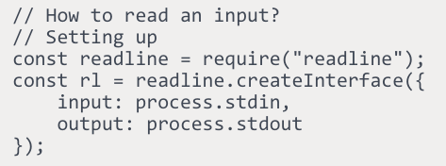
Two types of libraries
“packaged” libraries and modules - e.g. readline

Slide 11
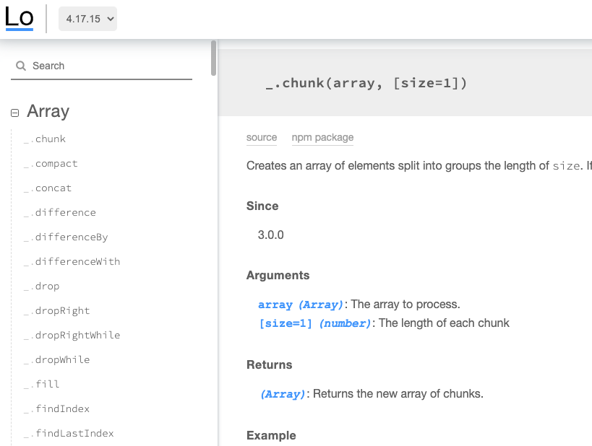

Two types of libraries
“Open sourced” libraries and modules - e.g. handling arrays and objects

Slide 12

How to find libraries?

Slide 13
Library for Handling User Input - prompt-sync

Slide 14
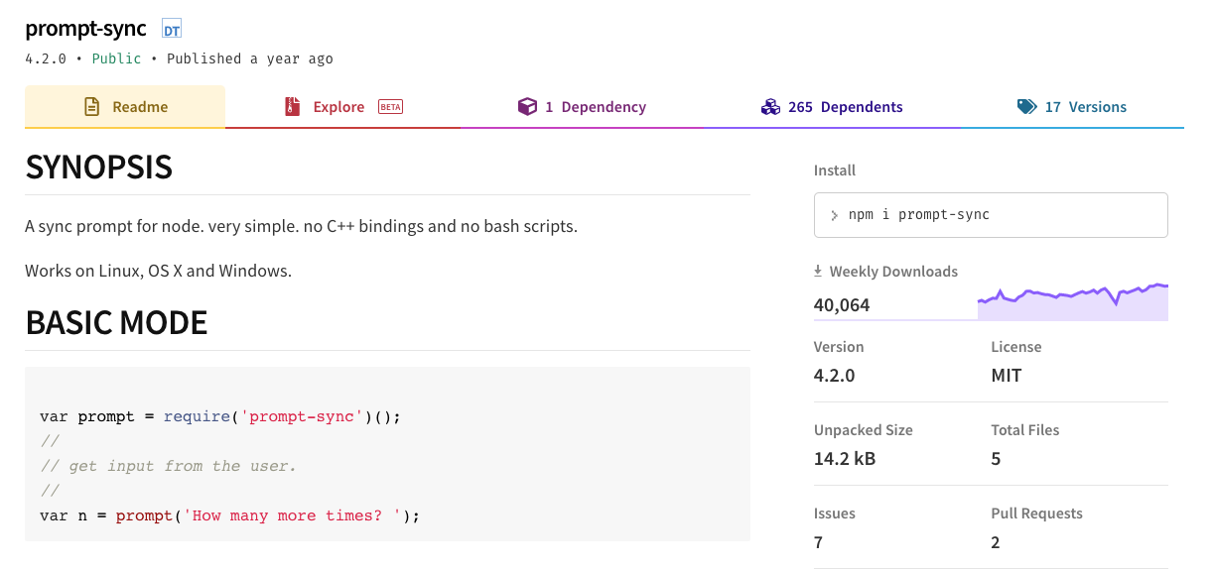
prompt-sync
var prompt = require('prompt-sync')({sigint: true});
var name = prompt('What is your name?');
console.log(`Hey there ${name}`);

Slide 15
prompt-sync
How to use it?
How to install it?
Need to pay for it?
Who own it?
Where to download it?

Slide 16

npm
package manager for JS
For installing open-source libraries
There are tons(i.e. millions) of libraries that can be used
For now, you only need to know how to install a library
  npm install prompt-sync --save
all the install packages are "local" to that project

Slide 17

How do I install a library?
Step 1 (only run once for each project):
> npm init
(It will ask you a series of questions, and generate a "npm project file”, named as package.json)
Step 2 (actually installing the library):
> npm install <library name> --save

Slide 18
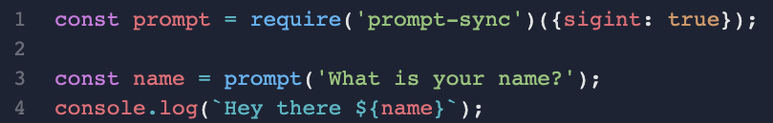
prompt-sync
Import the Library
Prompting the user with a sentence
Handle the User Input

Slide 19
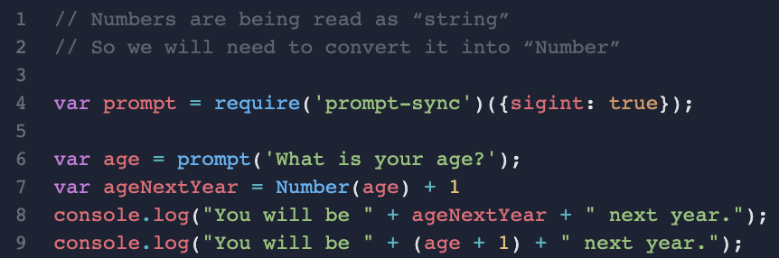
Be aware of numbers
Line 9 will print out “You will be 91 years old”
Line 8 will print out “You will be 10 years old”

Slide 20
How to structure a simple program?

Slide 21
Number Guessing Game Example
> What’s your name?
Darren
> Hello Darren, Let’s try to guess a number in my mind.
> I have a number in my mind. It is between 0-100, guess it
50
> It’s too large. Next guess?
25
> It’s too small. Next guess?
37
.
.
.

Slide 22

Steps
Think about what’s the process (from start to end), you can also use flow chart to help you
Layout the key steps in english/comments in your code.
Write the code and test it in small chunk

Slide 23
Assignment 9
To build a “number guessing” game
This time, I will do the step 1 for you (also step 2 in the code skeleton):
The program flow should be:
generate a number
keep asking user to “guess”
  on each guess, tell the user if the number is too big or too small
  if the “guess” is correct, then tell user that they win.
Bonus Point: after telling user that they win - start another game

